Slide 1
STREET LIGHT INTENSITY
BY
20951A0476
20951A0478

Slide 2
Abstract
Automation has created a bigger hype in the electronics.
The major reason for this hype is automation provides greater advantages like accuracy, energy conversation, reliability and more over the automated systems do not require any human attention.
Any one of the requirements stated above demands for the design of an automated device.
The energy conversation is very important in the current scenario and should be done to a maximum extent where ever it is possible.

Slide 3
Objectives & Significance
Street lighting provides a number of important benefits.
It can be used to promote security in urban areas and to increase the quality of life by artificially extending the hours in which it is light so that activity can take place.
The energy conversation is very important in the current scenario and should be done to a maximum extent where ever it is possible.
Energy can be effectively conserved if we can control the street lights on the highways by glowing them only when there is traffic on the road, and this is all most impossible to detect the arrival of a vehicle manually without the presence of light.

Slide 4
Background
A street light, light pole, lamppost, street lamp, light standard, or lamp standard is a raised source of light on the edge of a road or path.
Similar lights may be found on a railway platform. When urban electric power distribution became ubiquitous in developed countries in the 20th century, lights for urban streets followed, or sometimes LED .
Many lamps have light sensitive photocells that activate the lamp automatically when needed, at times when there is little-to-no ambient light, such as at dusk, dawn, or at the onset of dark weather conditions .
This function in older lighting systems could be performed with the aid of a solar dial

Slide 5
Problem Description
Energy conservation is very crucial in this critical era of huge usage of energy resources
Every embedded system requires dc voltage and that that will be 5v supply
We are getting 230v, 50 Hz in our house hold applications. We can be used to operate the home appliances like T.V, cooler, fan, light’s
Digital electronic devices need digital supply and we can get supply from regulated power supply block .
Some sort of good usage of power is using street lights in a efficient manner .

Slide 6
Proposed Solution
Microcontrollers are used in automatically controlled products and devices, such as automobile engine control systems, remote controls, office machines, appliances, power tools, and toys.
By reducing the size and cost compared to a design that uses a separate microprocessor, memory, and input/output devices, microcontrollers make it economical to digitally control even more devices and processes.
A microcontroller can be considered a self-contained system with a processor, memory and peripherals and can be used with an embedded system.

Slide 7
Detailed description of the Prototype or Product
The controlling device of the whole system is an arduino nano which is interface with LDR sensor, LED street lights, and IR sensor.
This project consist of LDR to detect the day/night time based on that it will control the intensity of the street light.IR sensor is used to detect the vehicle.
When the IR sensor detects the vehicle then the microcontroller will switch on the street lights with high intensity after passing the vehicle street lights will glows on 50% intensity.
To achieve this task microcontroller is loaded program written in embedded C language.

Slide 8
Detailed description of the Prototype or Product
A photo resistor or light dependent resistor or cadmium sulfide (CdS) cell is a resistor whose resistance decreases with increasing incident light intensity
It can also be referenced as a photo conductor . A photo resistor is made of a high resistance semiconductor.
If light falling on the device is of high enough frequency, photons absorbed by the semiconductor give bound electrons enough energy to jump into the conduction band.
The resulting free electron (and its hole partner) conduct electricity, thereby lowering resistance.

Slide 9
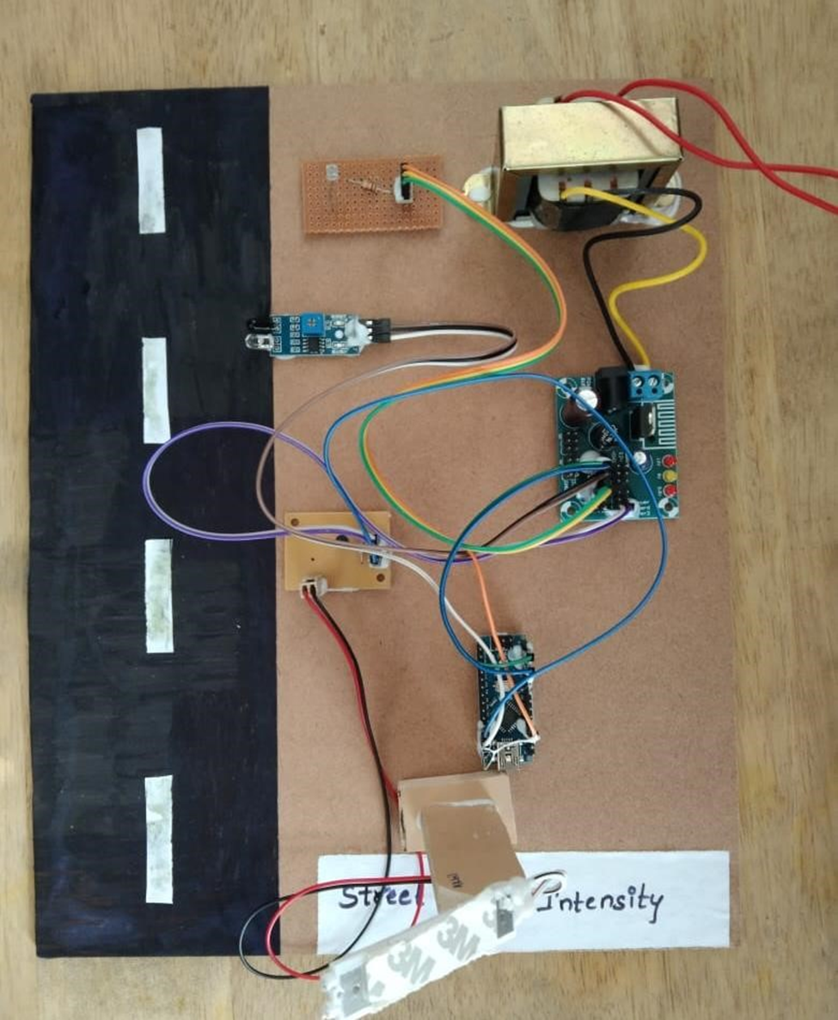
Design and Modeling

Slide 10
THANK YOU

